Slide 1

Neural Substrates of Attention and Awareness
Dan Birman
Gardner Lab
Frisem – 2015-04-17

Slide 4
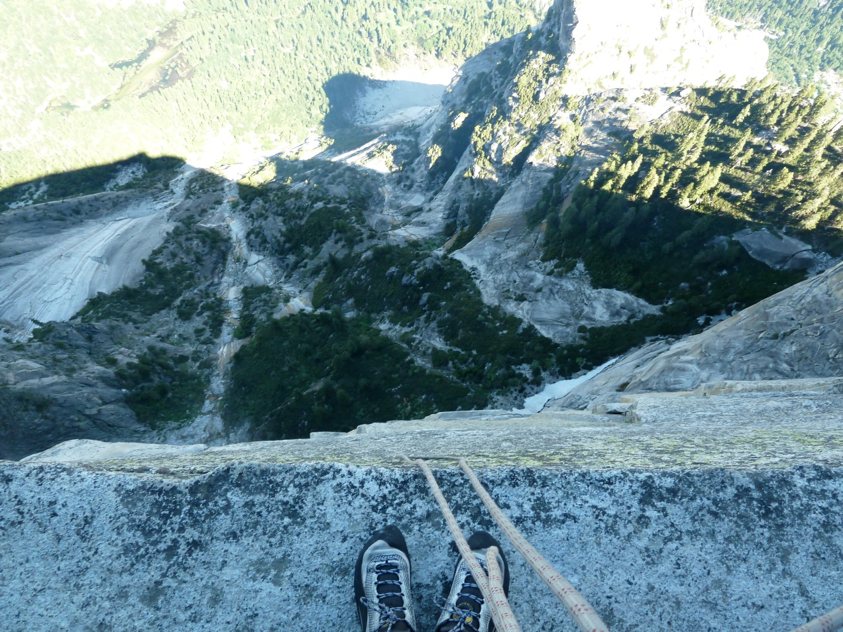

Slide 5
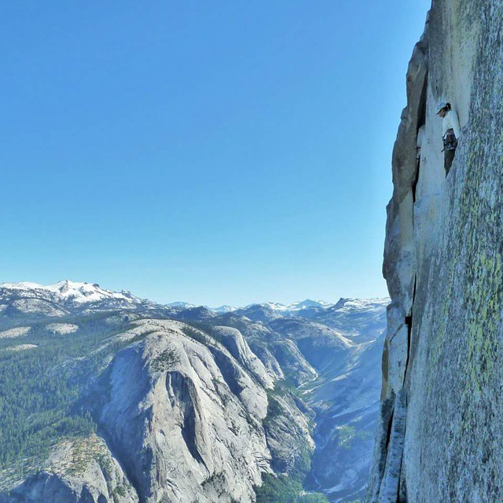

Slide 8
Neural Substrates of Attention and Awareness
Dan Birman
Gardner Lab
Frisem – 2015-04-17

Slide 11


Slide 12


Slide 13
Attention as a Pre-Requisite to Awareness
Dual task designs “pull” attention to one task, causing inattentional blindness for other stimuli.

Slide 14
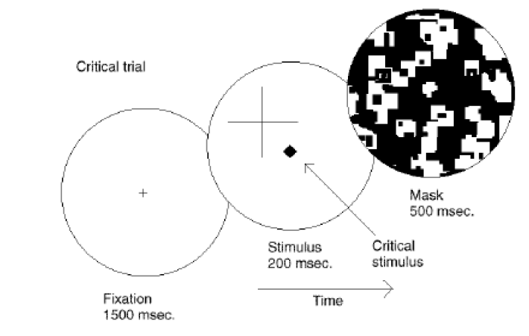
Attention as a Pre-Requisite to Awareness
Dual task designs “pull” attention to one task, causing inattentional blindness for other stimuli.
Mack & Rock, 1998
Notes:
There is one situation where attention (seems) to not be a pre-requisite for awareness

Slide 15
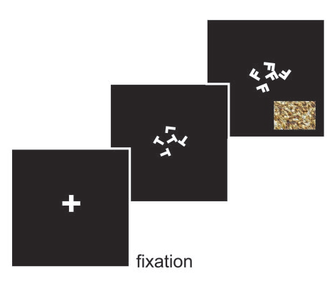
Gist Perception
Li et al., 2002

Slide 16
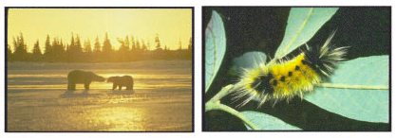
Gist Perception
Li et al., 2002

Slide 17
Gist Perception vs. Inattentional Blindness
“we believe […] there is no conscious perception without attention” (Mack & Rock, 1998)
“The close relationship between attention and
consciousness has led many scholars to conflate these processes“ (Koch & Tsuchiya, 2006)

Slide 18
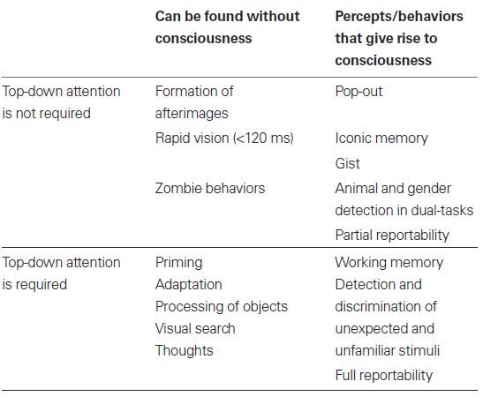
P
Perception of Stimulus:
Unaware
Aware
Unattended
Stimulus Is:
A
Attended

Slide 19
P
Perception of Stimulus:
Unaware
Aware
Unattended
Stimulus Is:
A
Attended

Slide 20
P
Perception of Stimulus:
Unaware
Aware
Unattended
Gist Perception
Stimulus Is:
A
Attended

Slide 21
P
Perception of Stimulus:
Unaware
Aware
Unattended
Inattentional
Blindness
Gist Perception
Stimulus Is:
A
Attended

Slide 22
P
Perception of Stimulus:
Unaware
Aware
Unattended
Inattentional
Blindness
Gist Perception
Stimulus Is:
A
Attended
Normal Vision

Slide 23
P
Jumble of Phenomena
Perception of Stimulus:
Unaware
Aware
Unattended
Inattentional
Blindness
Gist Perception
Stimulus Is:
A
Attended
Continuous Flash
Suppression
Normal Vision

Slide 24
P
Perception of Stimulus:
Unaware
Aware
Unattended
Inattentional
Blindness
Gist Perception
Stimulus Is:
A
Attended
Normal Vision

Slide 25
P
Perception of Stimulus:
Unaware
Aware
Unattended
Inattentional
Blindness
Gist Perception
Stimulus Is:
A
Attended
Normal Vision
Trajectory Depends on
Interaction Between
Stimuli

Slide 28
Cued: 85%
Attend to Contrast
Respond about Contrast
Catch: 15%
Attend to Contrast
Response about Motion Coherence

Slide 29
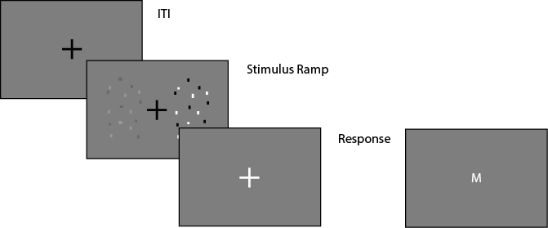
Task Design
Fixation: .4 - .8 s
Fixation
Stimulus Ramp: 1.4 s
Fixation
Response: 1.2 s (cued) / 3 s (catch)
Fixation

Slide 30
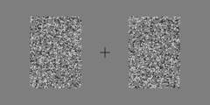
Task Design
Fixation
Stimulus Ramp: 1.4 s
Fixation
Response: 1.2 s (cued) / 3 s (catch)
Fixation

Slide 31
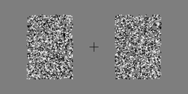
Task Design
Fixation
Stimulus Ramp: 1.4 s
Fixation
Response: 1.2 s (cued) / 3 s (catch)
Fixation

Slide 32
P
Perception of Stimulus:
Unaware
Aware
Unattended
Stimulus Is:
A
Attended

Slide 33
P
Perception of Stimulus:
Unaware
Aware
Catch: Coherence
Unattended
Stimulus Is:
A
Cued: Contrast
Attended

Slide 34
P
Perception of Stimulus:
Perceptually Identical:
Unaware
Perceptually Distinct:
Aware
Catch:
Unattended
Stimulus Is:
A
Cued:
Attended

Slide 35
P
Perception of Stimulus:
Perceptually Identical:
Unaware
Perceptually Distinct:
Aware
Catch:
Unattended
Stimulus Is:
A
Cued:
Attended

Slide 36
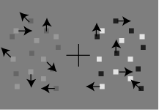
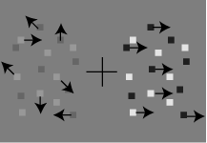
P
Perception of Stimulus:
Perceptually Identical:
Unaware
Perceptually Distinct:
Aware
Catch: Coherence
Unattended
Stimulus Is:
A
Cued: Contrast
Attended

Slide 37
Discrimination of Contrast
Attend to
Contrast
Effect On
Discrimination of Motion
Coherence

Slide 38

Mack & Rock
Attention is
Required for Awareness
Discrimination of Contrast
Attend to
Contrast
Effect On
Discrimination of Motion
Coherence

Slide 39

Mack & Rock
Attention is
Required for Awareness
Discrimination of Contrast
Attend to
Contrast
Effect On
Discrimination of Motion
Coherence
Attention and
Awareness are Distinct
Koch & Tsuchiya

Slide 40
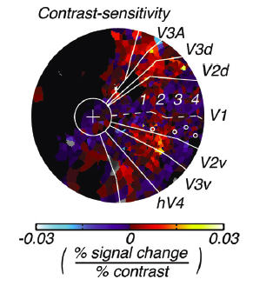
Contrast
Todo: Replace w/ my brain pictures
(and de-convolved data? Or glm betas?
Spend more time on these slides!!!
Cartoon view of the “model” of brain representations and their connections
Corrupt not Damage
Notes:
First attempt: dual

Slide 41
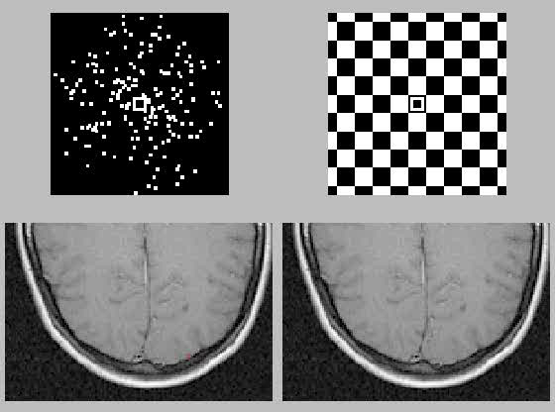
http://www.cns.nyu.edu/~david/courses/perception/lecturenotes/motion/motion.html

Slide 42
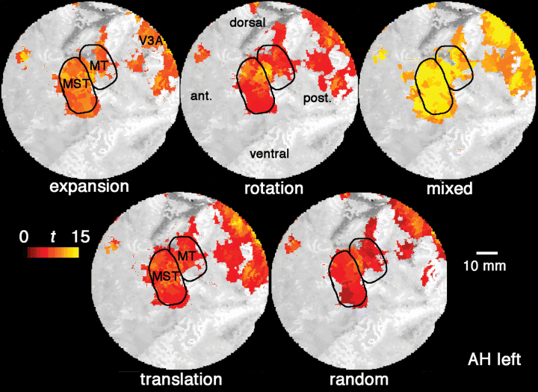
Attend to:
Contrast
Coherence
Discrimination of Contrast
Effect On
Discrimination of Motion
Coherence
Sensory Enhancement
of Contrast may
Feed Forward to MT

Slide 43
Sensory Enhancement
of Coherence is unlikely
to Feed Back to V1
Attend to:
Contrast
Coherence
Discrimination of Contrast
Effect On
Discrimination of Motion
Coherence

Slide 44
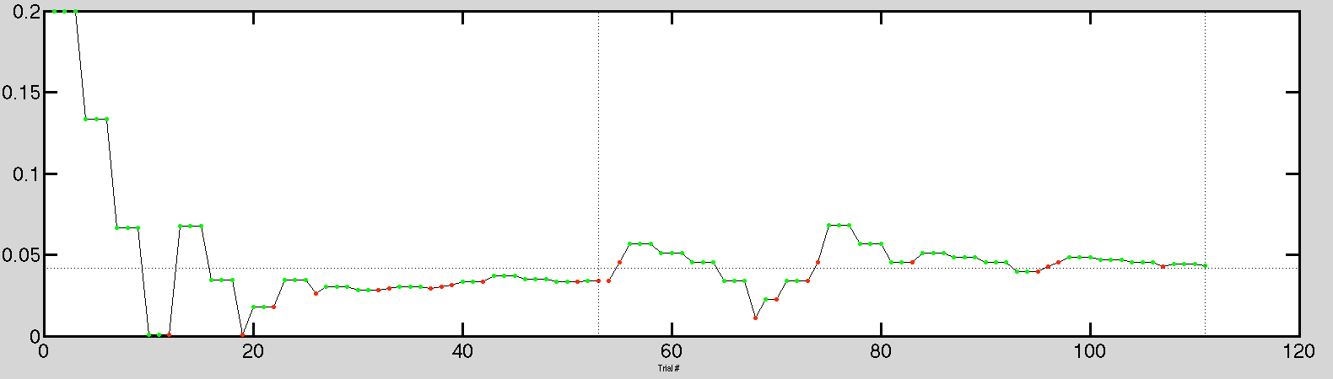
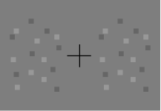
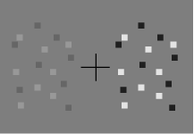
1-up 3-down Staircase (Pest Algorithm)
Stimulus Strength Difference
Trial #

Slide 45
Measuring Awareness
Performance (%)
Difference in Stimulus Strength

Slide 46
A Proxy for Awareness
Performance (%)
Difference in Stimulus Strength

Slide 47
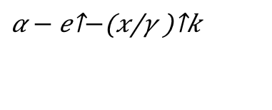
A Proxy for Awareness
Maximum Likelihood Fit:
Weibull Function
$$α − e^{−{\left(\frac{x}{γ}\right)}^{k}}$$
Performance (%)
Difference in Stimulus Strength

Slide 48
A Proxy for Awareness
Maximum Likelihood Fit:
Weibull Function
$$α − e^{−{\left(\frac{x}{γ}\right)}^{k}}$$
Performance (%)
Difference in Stimulus Strength

Slide 49
A Proxy for Awareness
80% Performance
Performance (%)
Difference in Stimulus Strength

Slide 50
A Proxy for Awareness

Slide 51
A Proxy for Awareness
Easier: Less Difference
Same Performance

Slide 52
A Proxy for Awareness
No Discrimination
Can Discriminate
What is the effect of cueing?

Slide 53
Effect of Attention

Slide 54
Effect of Attention
Performance (%)
Difference in Stimulus Strength

Slide 55
Effect of Attention
Performance (%)
Difference in Stimulus Strength

Slide 56

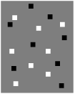
Effect of Attention
Bold Response Magnitude
Performance (%)
Difference in Stimulus Strength

Slide 57
Effect of Attention
Bold Response Magnitude
Performance (%)
Difference in Stimulus Strength

Slide 58
Effect of Attention
Bold Response Magnitude
Performance (%)
Difference in Stimulus Strength

Slide 59
Effect of Attention
Bold Response Magnitude
Performance (%)
Difference in Stimulus Strength

Slide 60
Effect of Attention
Bold Response Magnitude
Performance (%)
Difference in Stimulus Strength

Slide 61
Effect of Attention
Bold Response Magnitude
Performance (%)
Difference in Stimulus Strength

Slide 62
Attend to:
Contrast
Coherence
Discrimination of Contrast
Effect On
Discrimination of Motion
Coherence
Sensory Enhancement
of Contrast may
Feed Forward to MT

Slide 63
Sensory Enhancement
of Coherence is unlikely
to Feed Back to V1
Attend to:
Contrast
Coherence
Discrimination of Contrast
Effect On
Discrimination of Motion
Coherence

Slide 65
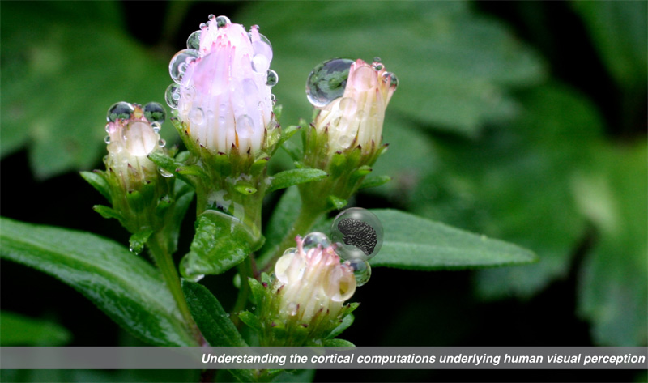

Gardner Lab @ Stanford University
Thank You!
Justin Gardner
Steeve Laquitaine
1st Year Cohort

Slide 66
response uncued instead of catch
add a slide where you do
cue: constrant -> respond: coherence WORKS / NOT in each of the mack/rock, koch/tsuchiya, neural substrate hypothesis
show the binned version
take out anything about staircases
here we do care about the thresolds: need ~30-50 trials, for the slopes we need ~300 trials

Slide 67
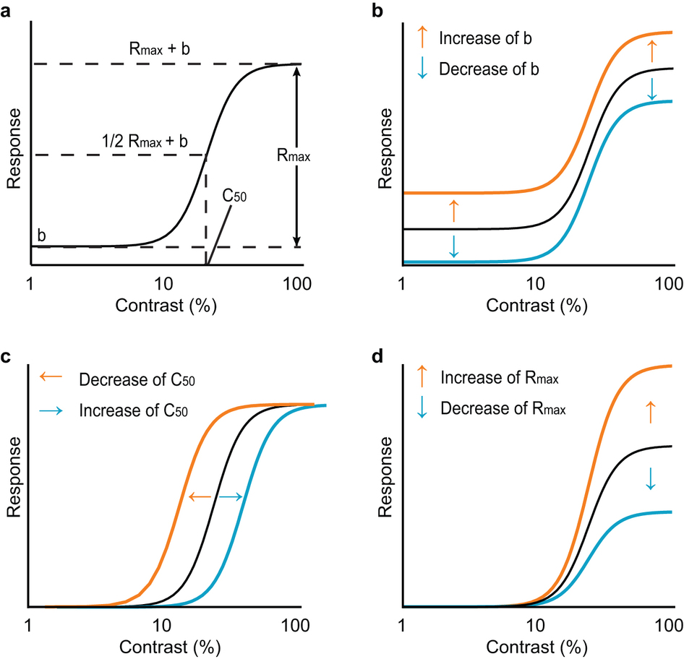
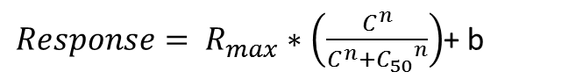
$Response= R_{max}∗\left(\frac{C^{n}}{C^{n}+{C_{50}}^{n}}\right)$+ b
Baseline Shift
Response Gain
Contrast Gain
Soma et al. 2013

Slide 68
Behavior in the Scanner
Outside
Inside Scanner

